Slide 1
C++ is Fun – Part 14 at Turbine/Warner Bros.!
Russell Hanson

Slide 2
Syllabus
1) First program and introduction to data types and control structures with applications for games learning how to use the programming environment Mar 25-27
2) Objects, encapsulation, abstract data types, data protection and scope April 1-3
3) Basic data structures and how to use them, opening files and performing operations on files – April 8-10
4) Algorithms on data structures, algorithms for specific tasks, simple AI and planning type algorithms, game AI algorithms April 15-17
Project 1 Due – April 17
5) More AI: search, heuristics, optimization, decision trees, supervised/unsupervised learning – April 22-24
6) Game API and/or event-oriented programming, model view controller, map reduce filter – April 29, May 1
7) Basic threads models and some simple databases SQLite May 6-8
8) Graphics programming, shaders, textures, 3D models and rotations May 13-15
Project 2 Due May 15
9) How to download an API and learn how to use functions in that API, Windows Foundation Classes May 20-22
10) Designing and implementing a simple game in C++ May 27-29
11) Selected topics – Gesture recognition & depth controllers like the Microsoft Kinect, Network Programming & TCP/IP, OSC June 3-5
12) Working on student projects - June 10-12
Final project presentations Project 3/Final Project Due June 12

Slide 3
Projects 2 Due in Class This Wednesday
Please prepare a ~10 minute discussion (PowerPoint, or other) about your program, or your goal with your project, challenges you encountered along the way, how you overcame them, how they overcame you, etc.
Share it with the class! 8)

Slide 4
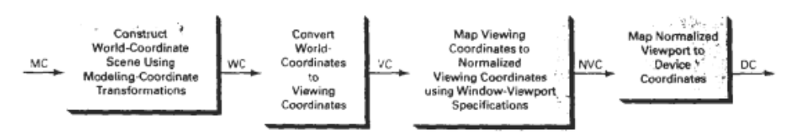
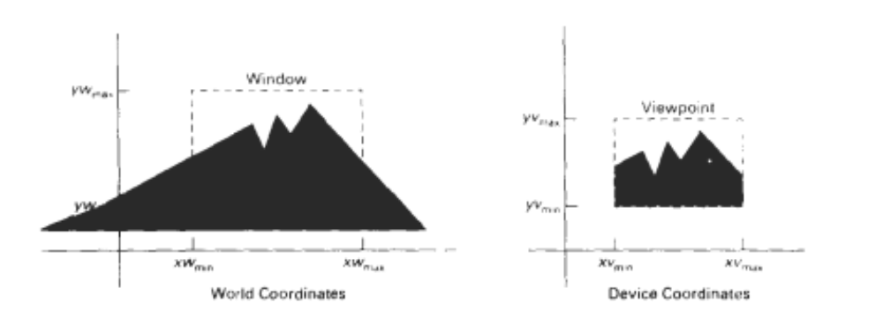
Two dimensional viewing-transformation pipeline

Slide 5
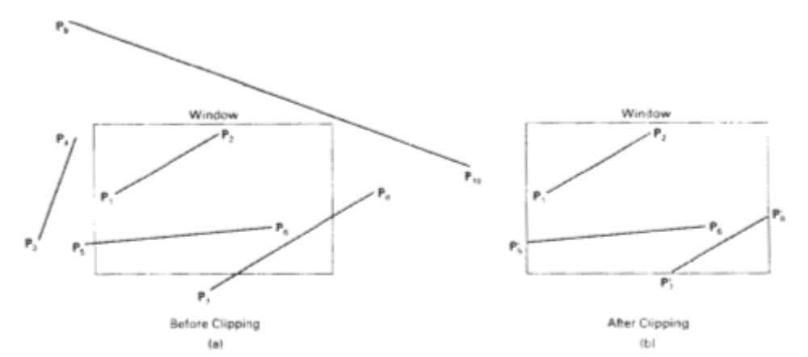
Line clipping against a rectangular clip window

Slide 6
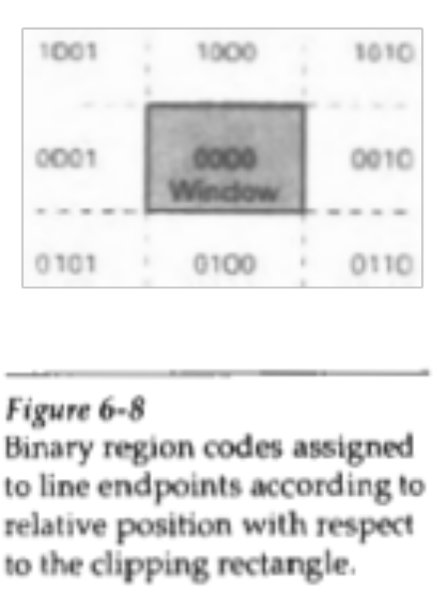
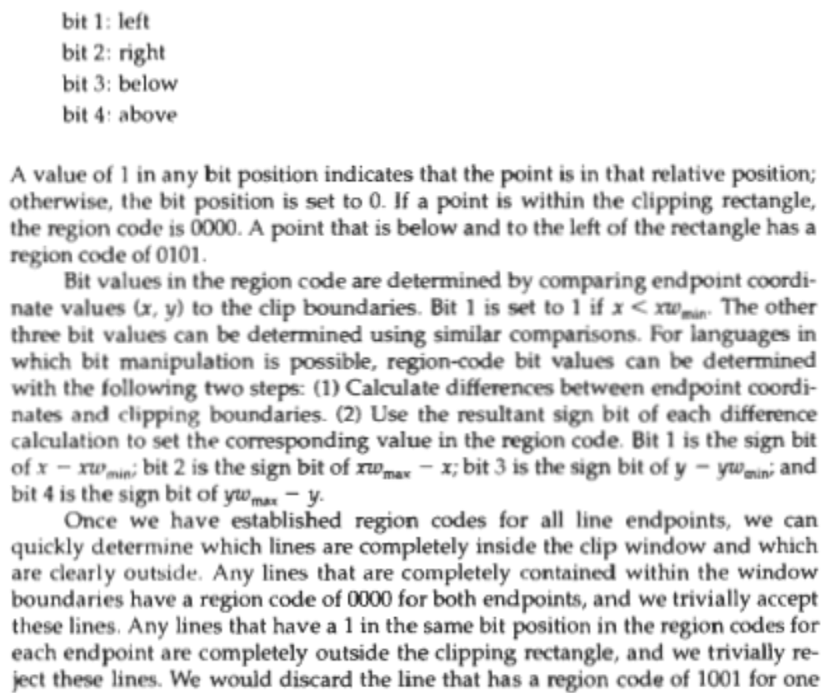
Line Clipping Algorithms

Slide 7
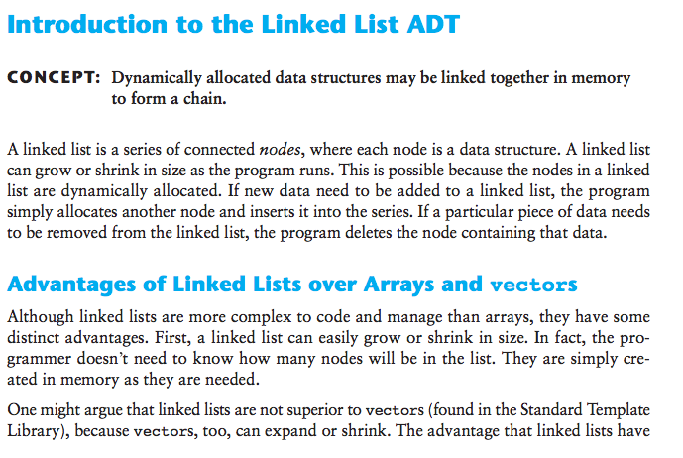
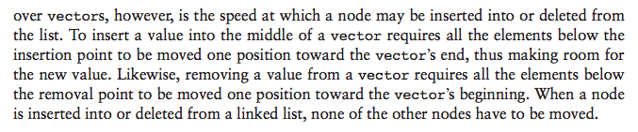
Linked Lists

Slide 8
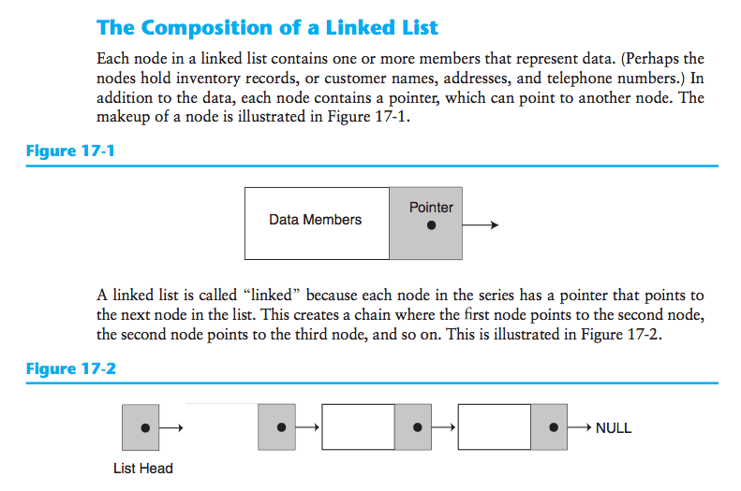

Slide 9
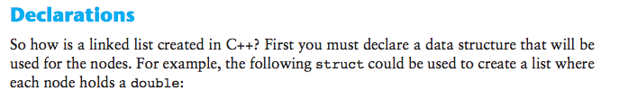
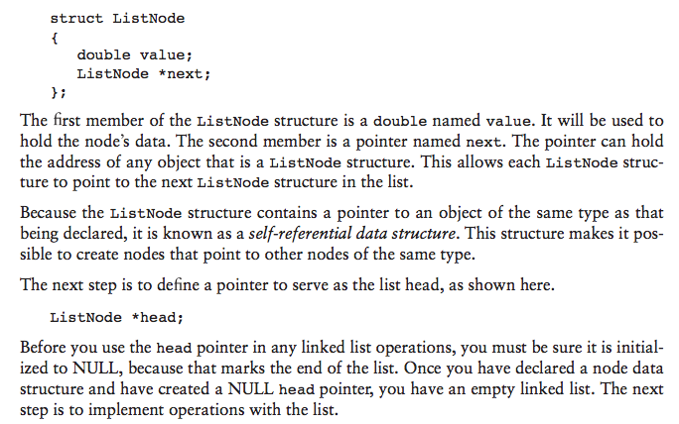

Slide 10
// Specification file for the NumberList class
#ifndef NUMBERLIST_H
#define NUMBERLIST_H
class NumberList
{
private:
// Declare a structure for the list
struct ListNode
{
double value; // The value in this node
struct ListNode *next; // To point to the next node
};
ListNode *head; // List head pointer
public:
// Constructor
NumberList()
{ head = NULL; }
// Destructor
~NumberList();
// Linked list operations
void appendNode(double);
void insertNode(double);
void deleteNode(double);
void displayList() const;
};
#endif

Slide 11
// Implementation file for the NumberList class
#include <iostream> // For cout and NULL
#include "NumberList.h"
using namespace std;
//**************************************************
// appendNode appends a node containing the *
// value pased into num, to the end of the list. *
//**************************************************
void NumberList::appendNode(double num)
{
ListNode *newNode; // To point to a new node
ListNode *nodePtr; // To move through the list
// Allocate a new node and store num there.
newNode = new ListNode;
newNode->value = num;
newNode->next = NULL;
// If there are no nodes in the list
// make newNode the first node.
if (!head)
head = newNode;
else // Otherwise, insert newNode at end.
{
// Initialize nodePtr to head of list.
nodePtr = head;
// Find the last node in the list.
while (nodePtr->next)
nodePtr = nodePtr->next;
// Insert newNode as the last node.
nodePtr->next = newNode;
}
}
//**************************************************
// displayList shows the value *
// stored in each node of the linked list *
// pointed to by head. *
//**************************************************
void NumberList::displayList() const
{
ListNode *nodePtr; // To move through the list
// Position nodePtr at the head of the list.
nodePtr = head;
// While nodePtr points to a node, traverse
// the list.
while (nodePtr)
{
// Display the value in this node.
cout << nodePtr->value << endl;
// Move to the next node.
nodePtr = nodePtr->next;
}
}
//**************************************************
// The insertNode function inserts a node with *
// num copied to its value member. *
//**************************************************
void NumberList::insertNode(double num)
{
ListNode *newNode; // A new node
ListNode *nodePtr; // To traverse the list
ListNode *previousNode = NULL; // The previous node
// Allocate a new node and store num there.
newNode = new ListNode;
newNode->value = num;
// If there are no nodes in the list
// make newNode the first node
if (!head)
{
head = newNode;
newNode->next = NULL;
}
else // Otherwise, insert newNode
{
// Position nodePtr at the head of list.
nodePtr = head;
// Initialize previousNode to NULL.
previousNode = NULL;
// Skip all nodes whose value is less than num.
while (nodePtr != NULL && nodePtr->value < num)
{
previousNode = nodePtr;
nodePtr = nodePtr->next;
}
// If the new node is to be the 1st in the list,
// insert it before all other nodes.
if (previousNode == NULL)
{
head = newNode;
newNode->next = nodePtr;
}
else // Otherwise insert after the previous node.
{
previousNode->next = newNode;
newNode->next = nodePtr;
}
}
}
//**************************************************
// The deleteNode function searches for a node *
// with num as its value. The node, if found, is *
// deleted from the list and from memory. *
//**************************************************
void NumberList::deleteNode(double num)
{
ListNode *nodePtr; // To traverse the list
ListNode *previousNode; // To point to the previous node
// If the list is empty, do nothing.
if (!head)
return;
// Determine if the first node is the one.
if (head->value == num)
{
nodePtr = head->next;
delete head;
head = nodePtr;
}
else
{
// Initialize nodePtr to head of list
nodePtr = head;
// Skip all nodes whose value member is
// not equal to num.
while (nodePtr != NULL && nodePtr->value != num)
{
previousNode = nodePtr;
nodePtr = nodePtr->next;
}
// If nodePtr is not at the end of the list,
// link the previous node to the node after
// nodePtr, then delete nodePtr.
if (nodePtr)
{
previousNode->next = nodePtr->next;
delete nodePtr;
}
}
}
//**************************************************
// Destructor *
// This function deletes every node in the list. *
//**************************************************
NumberList::~NumberList()
{
ListNode *nodePtr; // To traverse the list
ListNode *nextNode; // To point to the next node
// Position nodePtr at the head of the list.
nodePtr = head;
// While nodePtr is not at the end of the list...
while (nodePtr != NULL)
{
// Save a pointer to the next node.
nextNode = nodePtr->next;
// Delete the current node.
delete nodePtr;
// Position nodePtr at the next node.
nodePtr = nextNode;
}
}
// Implementation file for the NumberList class
#include <iostream> // For cout and NULL
#include "NumberList.h"
using namespace std;
//**************************************************
// appendNode appends a node containing the *
// value pased into num, to the end of the list. *
//**************************************************
void NumberList::appendNode(double num)
{
ListNode *newNode; // To point to a new node
ListNode *nodePtr; // To move through the list
// Allocate a new node and store num there.
newNode = new ListNode;
newNode->value = num;
newNode->next = NULL;
// If there are no nodes in the list
// make newNode the first node.
if (!head)
head = newNode;
else // Otherwise, insert newNode at end.
{
// Initialize nodePtr to head of list.
nodePtr = head;
// Find the last node in the list.
while (nodePtr->next)
nodePtr = nodePtr->next;
// Insert newNode as the last node.
nodePtr->next = newNode;
}
}
//**************************************************
// displayList shows the value *
// stored in each node of the linked list *
// pointed to by head. *
//**************************************************
void NumberList::displayList() const
{
ListNode *nodePtr; // To move through the list
// Position nodePtr at the head of the list.
nodePtr = head;
// While nodePtr points to a node, traverse
// the list.
while (nodePtr)
{
// Display the value in this node.
cout << nodePtr->value << endl;
// Move to the next node.
nodePtr = nodePtr->next;
}
}
//**************************************************
// The insertNode function inserts a node with *
// num copied to its value member. *
//**************************************************
void NumberList::insertNode(double num)
{
ListNode *newNode; // A new node
ListNode *nodePtr; // To traverse the list
ListNode *previousNode = NULL; // The previous node
// Allocate a new node and store num there.
newNode = new ListNode;
newNode->value = num;
// If there are no nodes in the list
// make newNode the first node
if (!head)
{
head = newNode;
newNode->next = NULL;
}
else // Otherwise, insert newNode
{
// Position nodePtr at the head of list.
nodePtr = head;
// Initialize previousNode to NULL.
previousNode = NULL;
// Skip all nodes whose value is less than num.
while (nodePtr != NULL && nodePtr->value < num)
{
previousNode = nodePtr;
nodePtr = nodePtr->next;
}
// If the new node is to be the 1st in the list,
// insert it before all other nodes.
if (previousNode == NULL)
{
head = newNode;
newNode->next = nodePtr;
}
else // Otherwise insert after the previous node.
{
previousNode->next = newNode;
newNode->next = nodePtr;
}
}
}
//**************************************************
// The deleteNode function searches for a node *
// with num as its value. The node, if found, is *
// deleted from the list and from memory. *
//**************************************************
void NumberList::deleteNode(double num)
{
ListNode *nodePtr; // To traverse the list
ListNode *previousNode; // To point to the previous node
// If the list is empty, do nothing.
if (!head)
return;
// Determine if the first node is the one.
if (head->value == num)
{
nodePtr = head->next;
delete head;
head = nodePtr;
}
else
{
// Initialize nodePtr to head of list
nodePtr = head;
// Skip all nodes whose value member is
// not equal to num.
while (nodePtr != NULL && nodePtr->value != num)
{
previousNode = nodePtr;
nodePtr = nodePtr->next;
}
// If nodePtr is not at the end of the list,
// link the previous node to the node after
// nodePtr, then delete nodePtr.
if (nodePtr)
{
previousNode->next = nodePtr->next;
delete nodePtr;
}
}
}
//**************************************************
// Destructor *
// This function deletes every node in the list. *
//**************************************************
NumberList::~NumberList()
{
ListNode *nodePtr; // To traverse the list
ListNode *nextNode; // To point to the next node
// Position nodePtr at the head of the list.
nodePtr = head;
// While nodePtr is not at the end of the list...
while (nodePtr != NULL)
{
// Save a pointer to the next node.
nextNode = nodePtr->next;
// Delete the current node.
delete nodePtr;
// Position nodePtr at the next node.
nodePtr = nextNode;
}
}

Slide 12
// Implementation file for the NumberList class
#include <iostream> // For cout and NULL
#include "NumberList.h"
using namespace std;
//**************************************************
// appendNode appends a node containing the *
// value pased into num, to the end of the list. *
//**************************************************
void NumberList::appendNode(double num)
{
ListNode *newNode; // To point to a new node
ListNode *nodePtr; // To move through the list
// Allocate a new node and store num there.
newNode = new ListNode;
newNode->value = num;
newNode->next = NULL;
// If there are no nodes in the list
// make newNode the first node.
if (!head)
head = newNode;
else // Otherwise, insert newNode at end.
{
// Initialize nodePtr to head of list.
nodePtr = head;
// Find the last node in the list.
while (nodePtr->next)
nodePtr = nodePtr->next;
// Insert newNode as the last node.
nodePtr->next = newNode;
}
}
//**************************************************
// displayList shows the value *
// stored in each node of the linked list *
// pointed to by head. *
//**************************************************
void NumberList::displayList() const
{
ListNode *nodePtr; // To move through the list
// Position nodePtr at the head of the list.
nodePtr = head;
// While nodePtr points to a node, traverse
// the list.
while (nodePtr)
{
// Display the value in this node.
cout << nodePtr->value << endl;
// Move to the next node.
nodePtr = nodePtr->next;
}
}
//**************************************************
// The insertNode function inserts a node with *
// num copied to its value member. *
//**************************************************
void NumberList::insertNode(double num)
{
ListNode *newNode; // A new node
ListNode *nodePtr; // To traverse the list
ListNode *previousNode = NULL; // The previous node
// Allocate a new node and store num there.
newNode = new ListNode;
newNode->value = num;
// If there are no nodes in the list
// make newNode the first node
if (!head)
{
head = newNode;
newNode->next = NULL;
}
else // Otherwise, insert newNode
{
// Position nodePtr at the head of list.
nodePtr = head;
// Initialize previousNode to NULL.
previousNode = NULL;
// Skip all nodes whose value is less than num.
while (nodePtr != NULL && nodePtr->value < num)
{
previousNode = nodePtr;
nodePtr = nodePtr->next;
}
// If the new node is to be the 1st in the list,
// insert it before all other nodes.
if (previousNode == NULL)
{
head = newNode;
newNode->next = nodePtr;
}
else // Otherwise insert after the previous node.
{
previousNode->next = newNode;
newNode->next = nodePtr;
}
}
}
//**************************************************
// The deleteNode function searches for a node *
// with num as its value. The node, if found, is *
// deleted from the list and from memory. *
//**************************************************
void NumberList::deleteNode(double num)
{
ListNode *nodePtr; // To traverse the list
ListNode *previousNode; // To point to the previous node
// If the list is empty, do nothing.
if (!head)
return;
// Determine if the first node is the one.
if (head->value == num)
{
nodePtr = head->next;
delete head;
head = nodePtr;
}
else
{
// Initialize nodePtr to head of list
nodePtr = head;
// Skip all nodes whose value member is
// not equal to num.
while (nodePtr != NULL && nodePtr->value != num)
{
previousNode = nodePtr;
nodePtr = nodePtr->next;
}
// If nodePtr is not at the end of the list,
// link the previous node to the node after
// nodePtr, then delete nodePtr.
if (nodePtr)
{
previousNode->next = nodePtr->next;
delete nodePtr;
}
}
}
//**************************************************
// Destructor *
// This function deletes every node in the list. *
//**************************************************
NumberList::~NumberList()
{
ListNode *nodePtr; // To traverse the list
ListNode *nextNode; // To point to the next node
// Position nodePtr at the head of the list.
nodePtr = head;
// While nodePtr is not at the end of the list...
while (nodePtr != NULL)
{
// Save a pointer to the next node.
nextNode = nodePtr->next;
// Delete the current node.
delete nodePtr;
// Position nodePtr at the next node.
nodePtr = nextNode;
}
}
// Implementation file for the NumberList class
#include <iostream> // For cout and NULL
#include "NumberList.h"
using namespace std;
//**************************************************
// appendNode appends a node containing the *
// value pased into num, to the end of the list. *
//**************************************************
void NumberList::appendNode(double num)
{
ListNode *newNode; // To point to a new node
ListNode *nodePtr; // To move through the list
// Allocate a new node and store num there.
newNode = new ListNode;
newNode->value = num;
newNode->next = NULL;
// If there are no nodes in the list
// make newNode the first node.
if (!head)
head = newNode;
else // Otherwise, insert newNode at end.
{
// Initialize nodePtr to head of list.
nodePtr = head;
// Find the last node in the list.
while (nodePtr->next)
nodePtr = nodePtr->next;
// Insert newNode as the last node.
nodePtr->next = newNode;
}
}
//**************************************************
// displayList shows the value *
// stored in each node of the linked list *
// pointed to by head. *
//**************************************************
void NumberList::displayList() const
{
ListNode *nodePtr; // To move through the list
// Position nodePtr at the head of the list.
nodePtr = head;
// While nodePtr points to a node, traverse
// the list.
while (nodePtr)
{
// Display the value in this node.
cout << nodePtr->value << endl;
// Move to the next node.
nodePtr = nodePtr->next;
}
}
//**************************************************
// The insertNode function inserts a node with *
// num copied to its value member. *
//**************************************************
void NumberList::insertNode(double num)
{
ListNode *newNode; // A new node
ListNode *nodePtr; // To traverse the list
ListNode *previousNode = NULL; // The previous node
// Allocate a new node and store num there.
newNode = new ListNode;
newNode->value = num;
// If there are no nodes in the list
// make newNode the first node
if (!head)
{
head = newNode;
newNode->next = NULL;
}
else // Otherwise, insert newNode
{
// Position nodePtr at the head of list.
nodePtr = head;
// Initialize previousNode to NULL.
previousNode = NULL;
// Skip all nodes whose value is less than num.
while (nodePtr != NULL && nodePtr->value < num)
{
previousNode = nodePtr;
nodePtr = nodePtr->next;
}
// If the new node is to be the 1st in the list,
// insert it before all other nodes.
if (previousNode == NULL)
{
head = newNode;
newNode->next = nodePtr;
}
else // Otherwise insert after the previous node.
{
previousNode->next = newNode;
newNode->next = nodePtr;
}
}
}
//**************************************************
// The deleteNode function searches for a node *
// with num as its value. The node, if found, is *
// deleted from the list and from memory. *
//**************************************************
void NumberList::deleteNode(double num)
{
ListNode *nodePtr; // To traverse the list
ListNode *previousNode; // To point to the previous node
// If the list is empty, do nothing.
if (!head)
return;
// Determine if the first node is the one.
if (head->value == num)
{
nodePtr = head->next;
delete head;
head = nodePtr;
}
else
{
// Initialize nodePtr to head of list
nodePtr = head;
// Skip all nodes whose value member is
// not equal to num.
while (nodePtr != NULL && nodePtr->value != num)
{
previousNode = nodePtr;
nodePtr = nodePtr->next;
}
// If nodePtr is not at the end of the list,
// link the previous node to the node after
// nodePtr, then delete nodePtr.
if (nodePtr)
{
previousNode->next = nodePtr->next;
delete nodePtr;
}
}
}
//**************************************************
// Destructor *
// This function deletes every node in the list. *
//**************************************************
NumberList::~NumberList()
{
ListNode *nodePtr; // To traverse the list
ListNode *nextNode; // To point to the next node
// Position nodePtr at the head of the list.
nodePtr = head;
// While nodePtr is not at the end of the list...
while (nodePtr != NULL)
{
// Save a pointer to the next node.
nextNode = nodePtr->next;
// Delete the current node.
delete nodePtr;
// Position nodePtr at the next node.
nodePtr = nextNode;
}
}

Slide 13
Russells-MacBook-Pro-2:Chapter 17 russell$ cat Pr17-1.cpp
// This program demonstrates a simple append
// operation on a linked list.
#include <iostream>
#include "NumberList.h"
using namespace std;
int main()
{
// Define a NumberList object.
NumberList list;
// Append some values to the list.
list.appendNode(2.5);
list.appendNode(7.9);
list.appendNode(12.6);
list.displayList();
return 0;
}
Russells-MacBook-Pro-2:Chapter 17 russell$ g++ Pr17-1.cpp NumberList.cpp
Russells-MacBook-Pro-2:Chapter 17 russell$ ./a.out
2.5
7.9
12.6
Class Exercise: Append nodes to
LinkedList

Slide 14
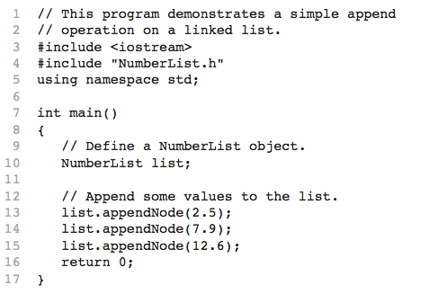

Slide 15
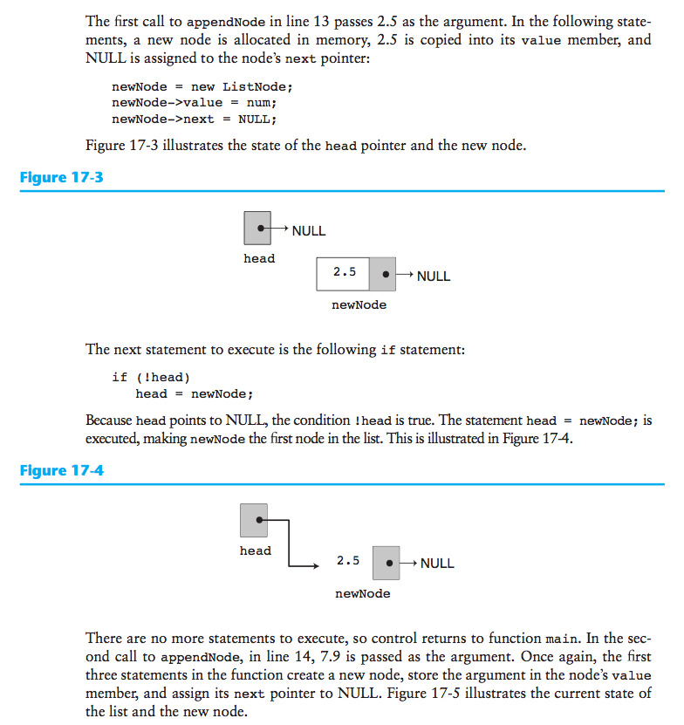

Slide 16
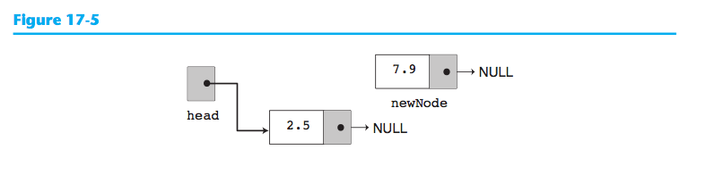
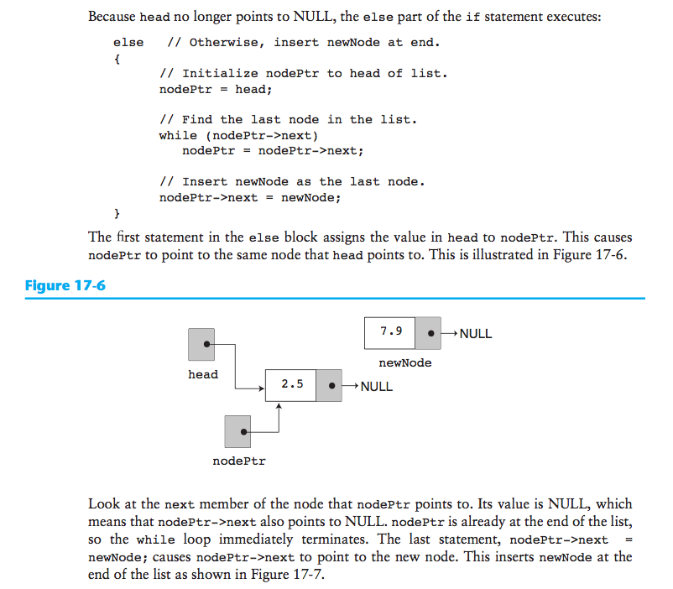

Slide 17
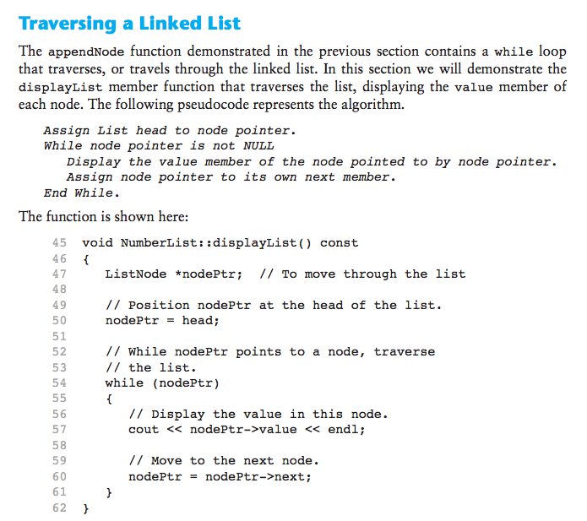

Slide 18
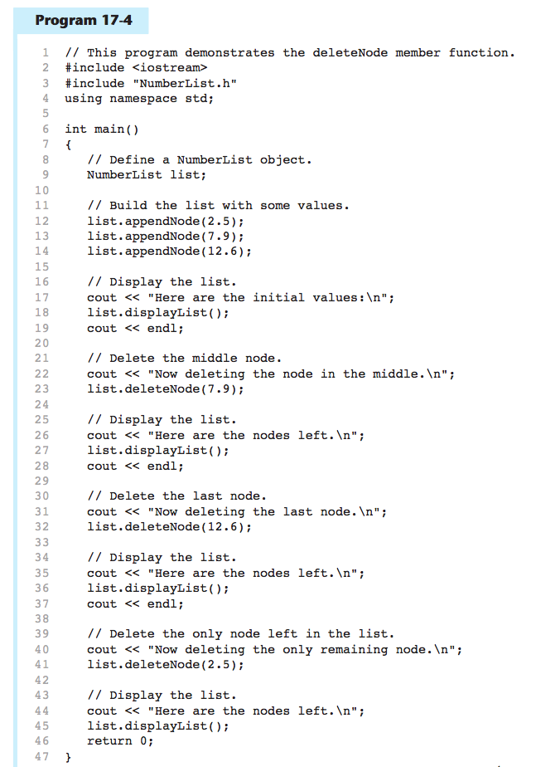

Slide 19
$ ./4out
Here are the initial values:
2.5
7.9
12.6
Now deleting the node in the middle.
Here are the nodes left.
2.5
12.6
Now deleting the last node.
Here are the nodes left.
2.5
Now deleting the only remaining node.
Here are the nodes left.

Slide 20
Recall, Project 2 due this Wednesday ☺

Slide 21
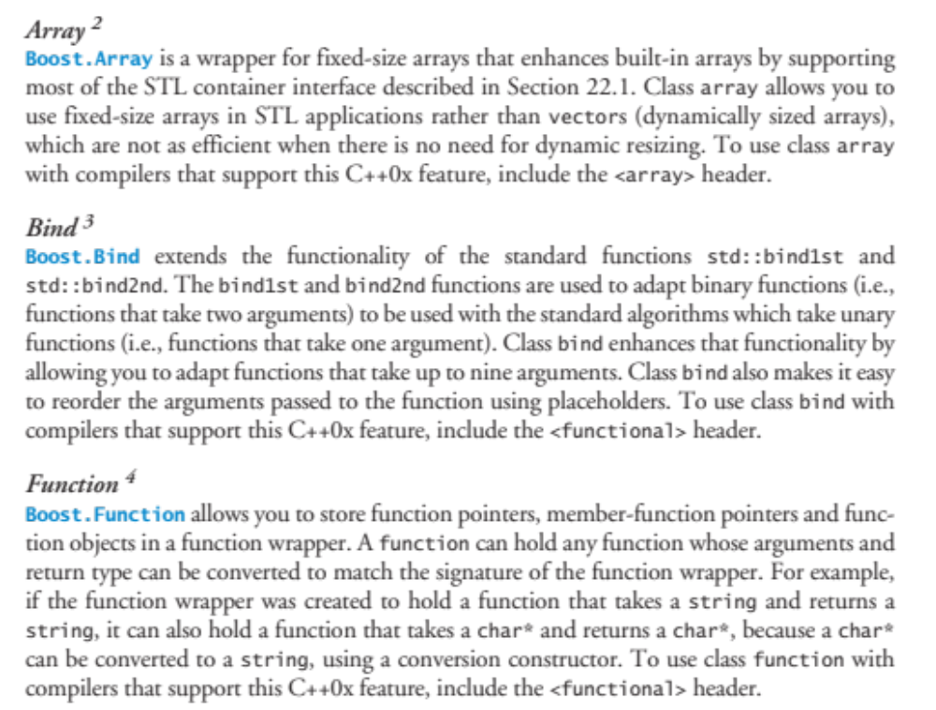
Boost Libraries

Slide 22
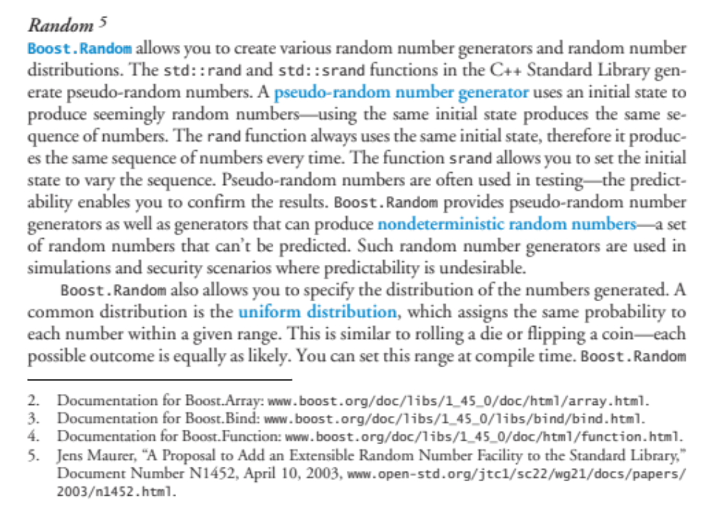

Slide 23
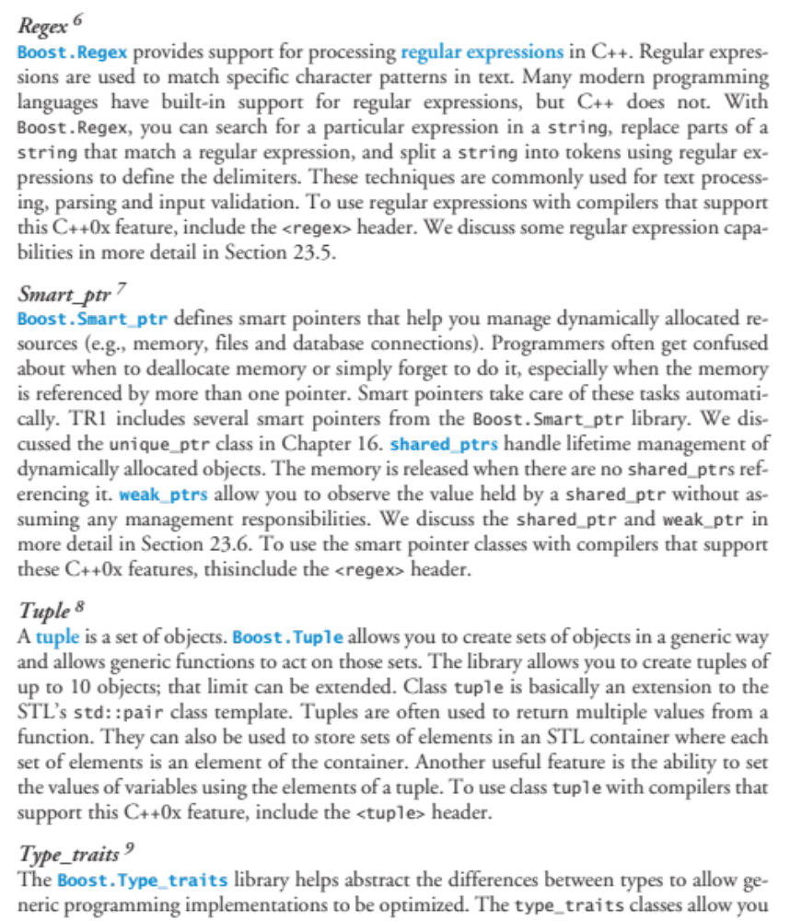

Slide 24
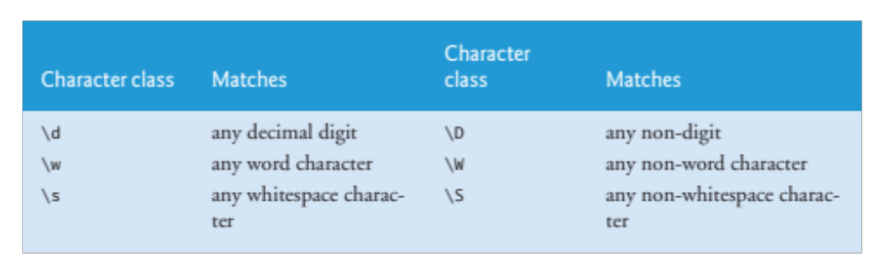

Boost Libraries

Slide 25
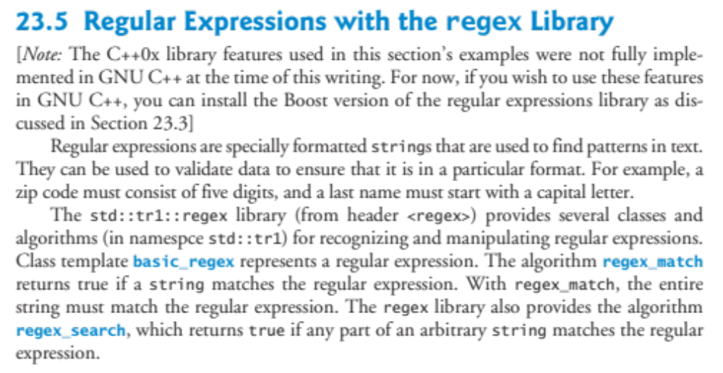
$ g++ fig23_02.cpp
fig23_02.cpp:5:17: error: regex: No such file or directory
fig23_02.cpp: In function ‘int main()’:
fig23_02.cpp:11: error: ‘regex’ was not declared in this scope
fig23_02.cpp:11: error: expected `;' before ‘expression’
fig23_02.cpp:20: error: ‘smatch’ was not declared in this scope
fig23_02.cpp:20: error: expected `;' before ‘match’
fig23_02.cpp:23: error: ‘match’ was not declared in this scope
fig23_02.cpp:23: error: ‘expression’ was not declared in this scope
fig23_02.cpp:24: error: ‘regex_constants’ has not been declared
fig23_02.cpp:24: error: ‘regex_search’ was not declared in this scope

Slide 26
// Demonstrating regular expressions.
#include <iostream>
#include <string>
#include <regex>
using namespace std; // allows use of features in both std and std::tr1
int main()
{
// create a regular expression
regex expression( "J.*\\d[0-35-9]-\\d\\d-\\d\\d" );
// create a string to be tested
string string1 = "Jane's Birthday is 05-12-75\n"
"Dave's Birthday is 11-04-68\n"
"John's Birthday is 04-28-73\n"
"Joe's Birthday is 12-17-77”;
// create a std::tr1::smatch object to hold the search results
smatch match;
// match regular expression to string and print out all matches
while ( regex_search( string1, match, expression,
regex_constants::match_not_eol ) )
{
cout << match.str() << endl; // print the matching string
// remove the matched substring from the string
string1 = match.suffix();
} // end while
} // end of function main

Slide 27
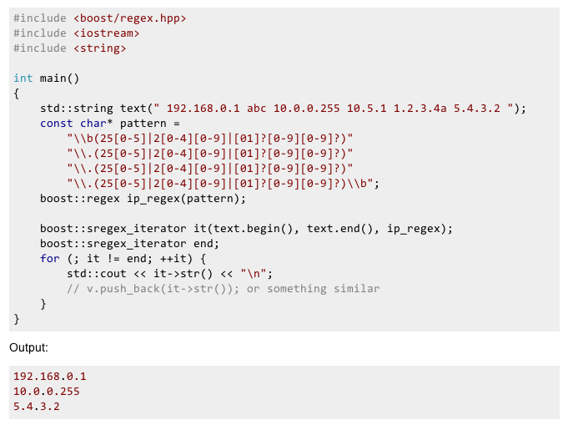

Slide 28
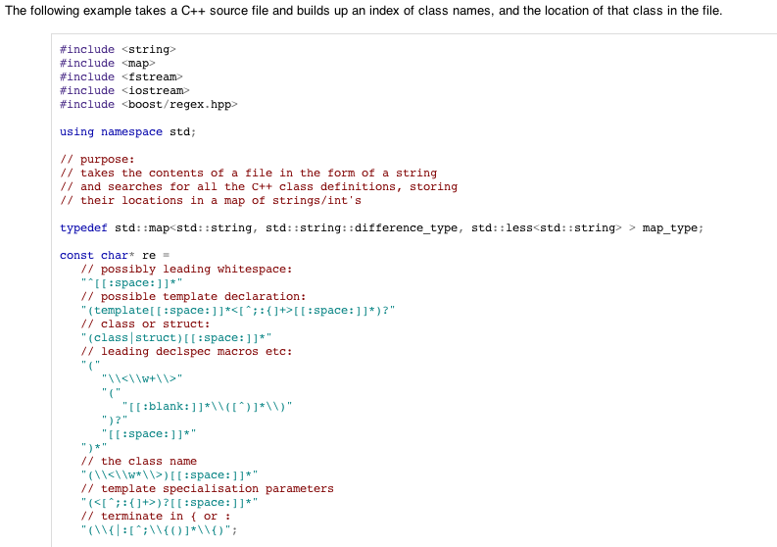

Slide 29
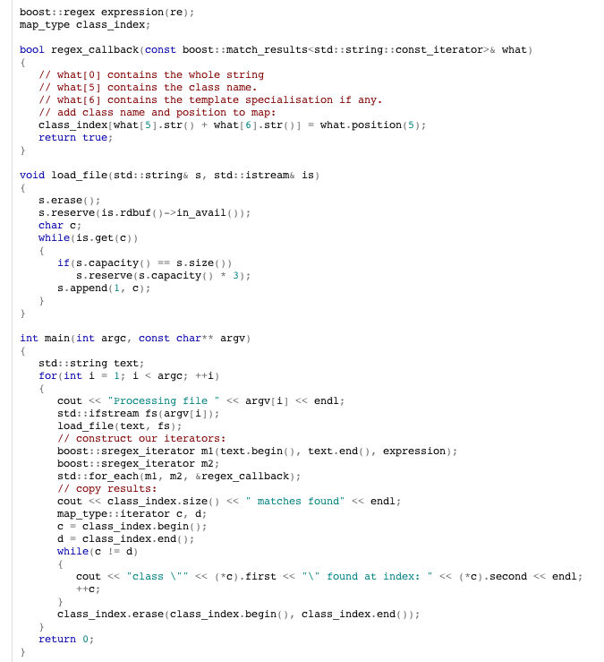

Slide 30
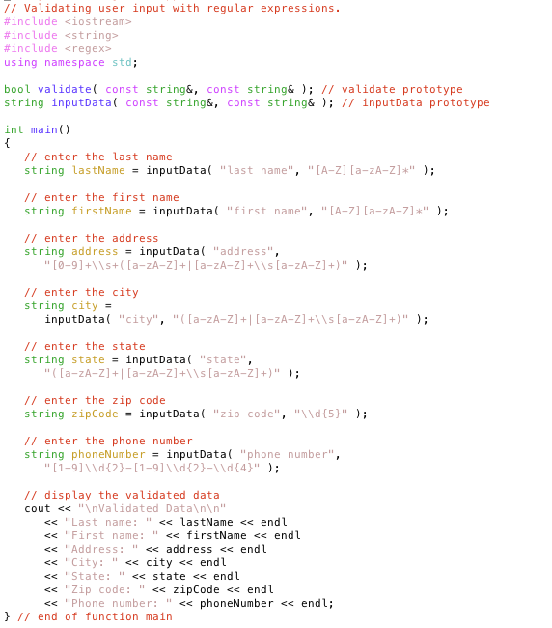
Validating User Input with Regex & Boost

Slide 31
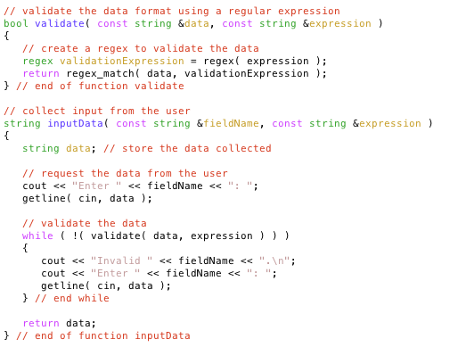

Slide 32
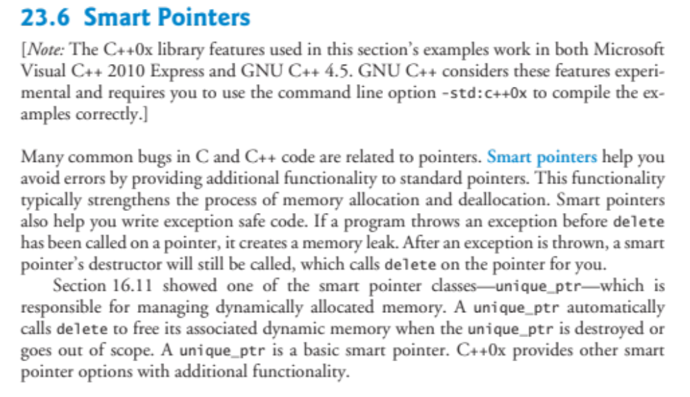

Slide 33
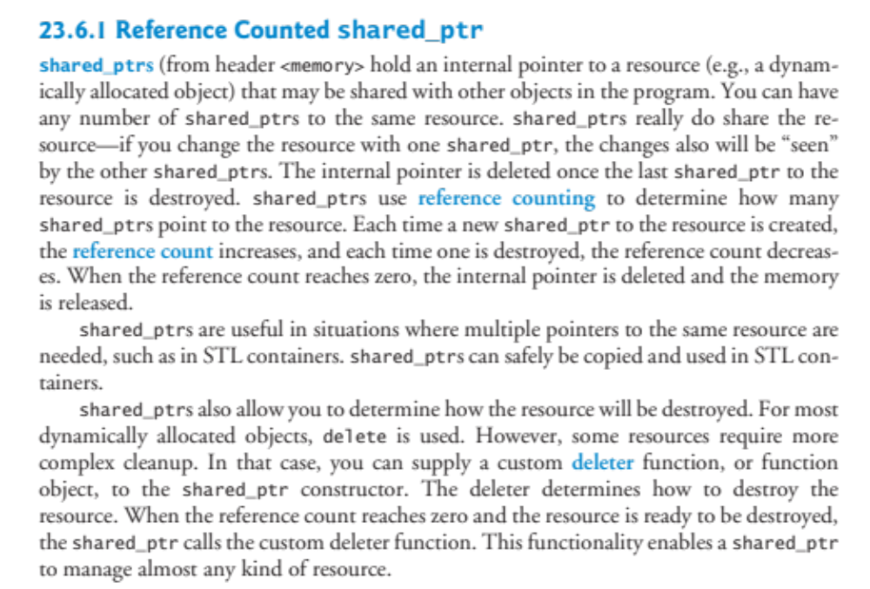

Slide 34
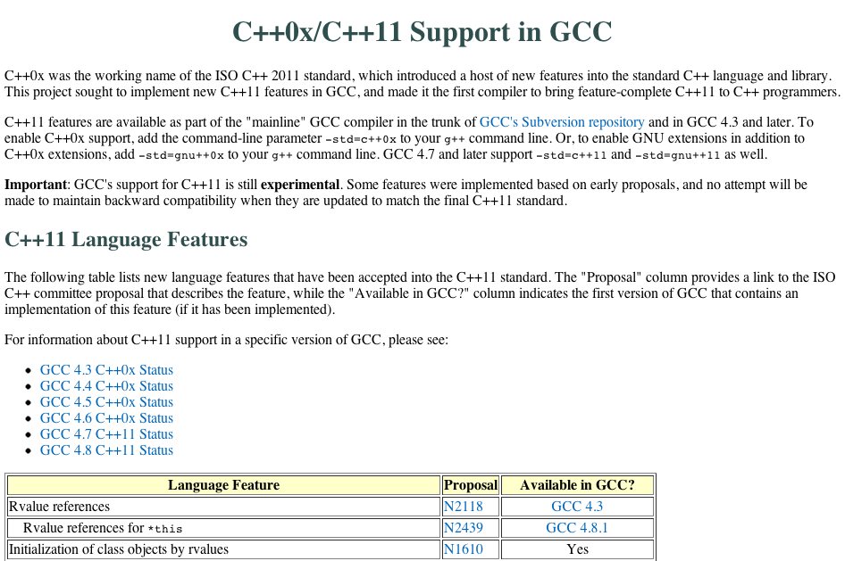

Slide 35
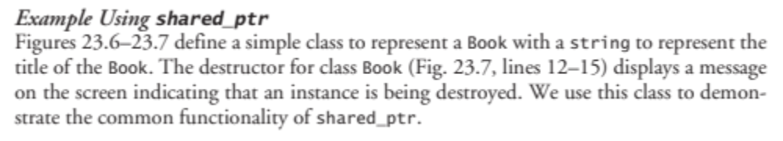
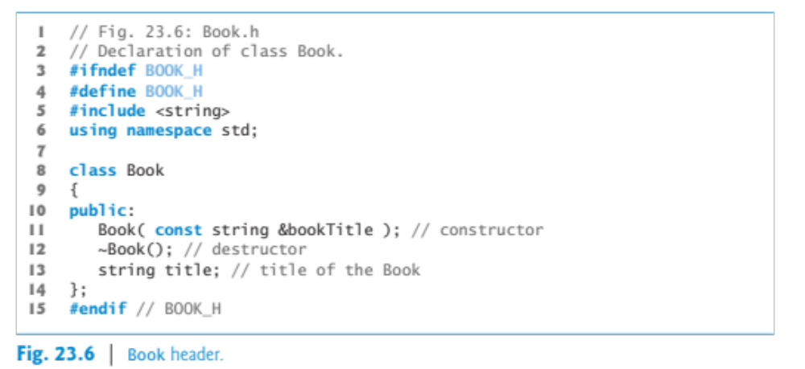
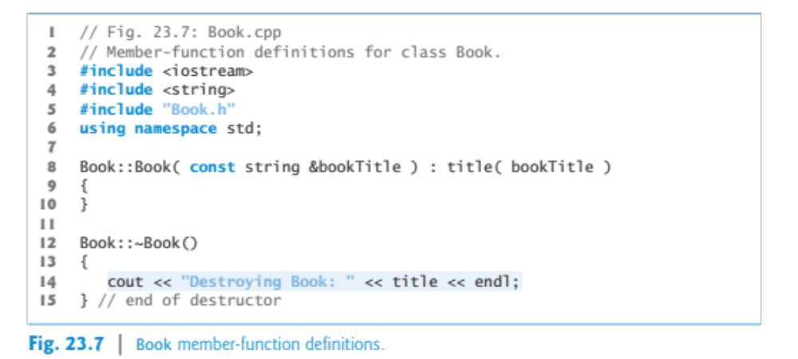
Book.h, Book.cpp, and
SharedPtrExample.cpp are
in the Google Drive

Slide 36
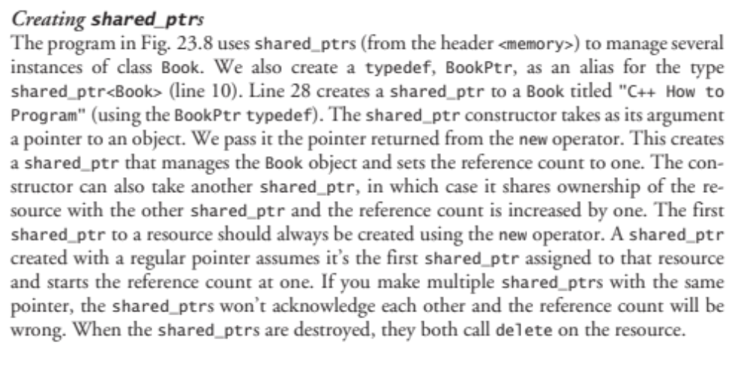

Slide 37
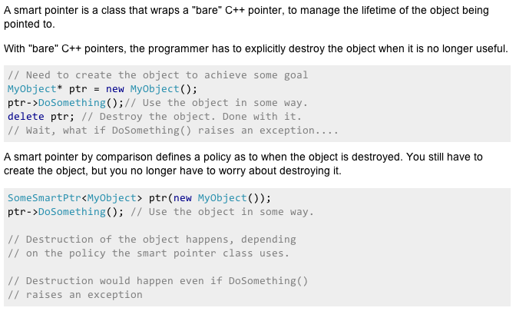

Slide 38
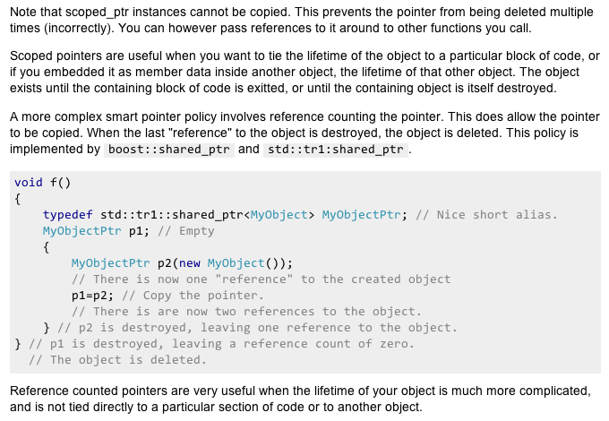

Slide 39
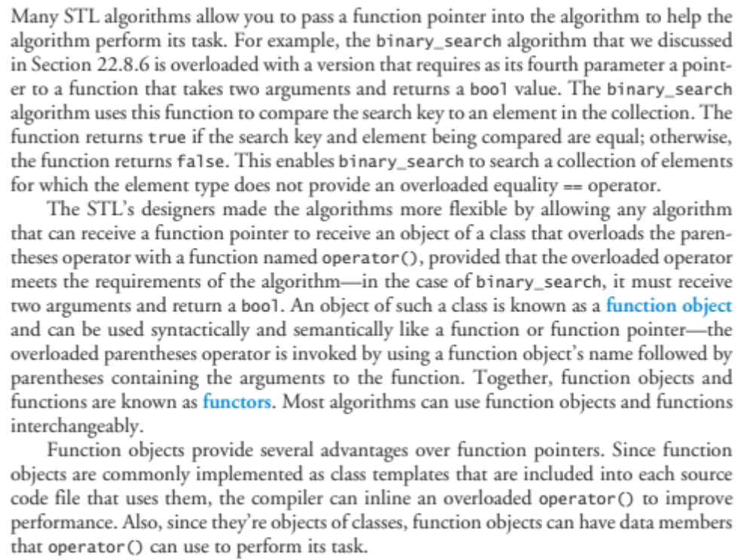
Function objects in the STL

Slide 40
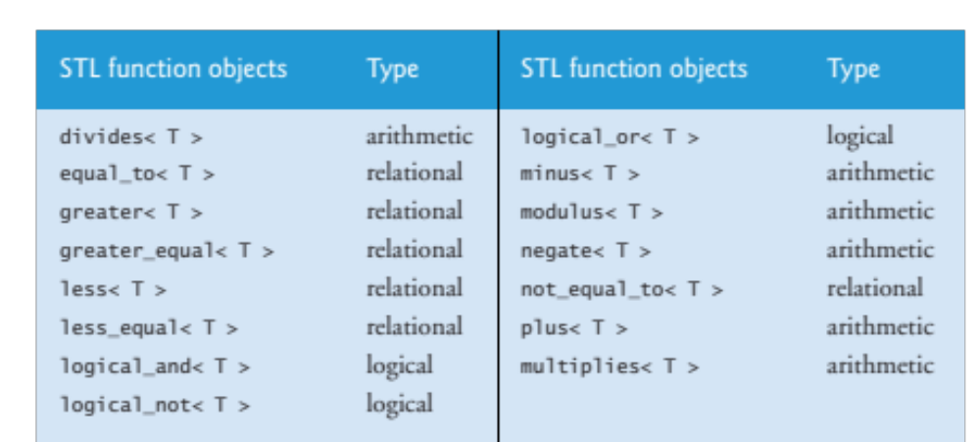

Slide 41
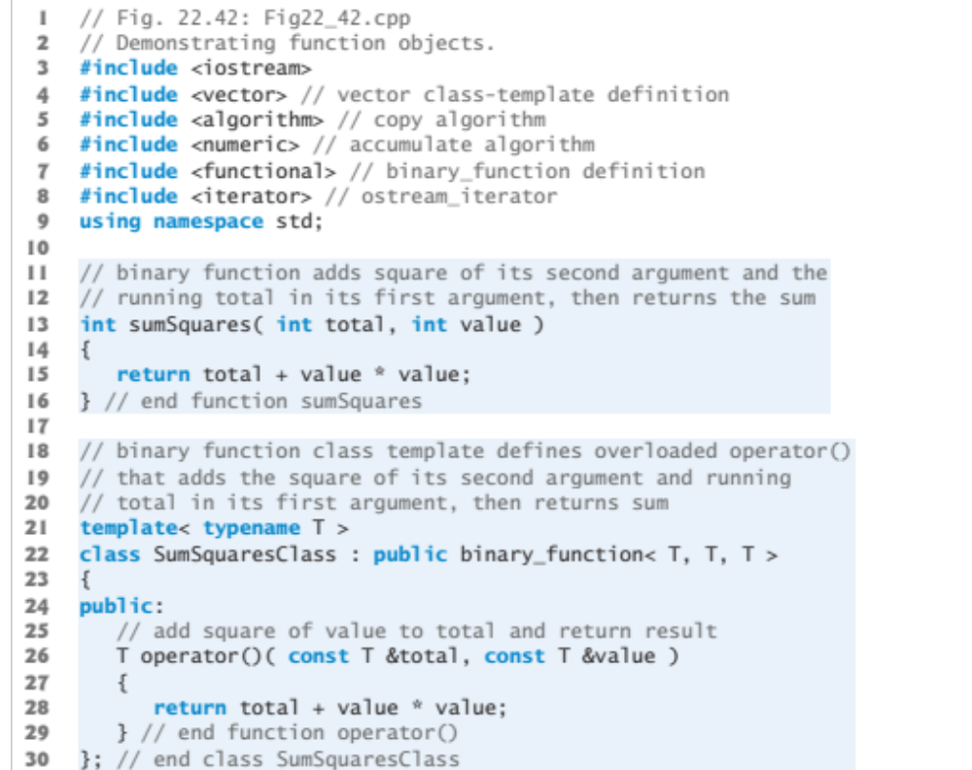

Slide 42
Ende

